Slide 1
Importance of HCI
in
Aatmanirbhar
An online Stock Simulator
Team 15:
Deep Singh 18BCE2132
Pratishtha Gaur 19BCE0104
Abhinav Chawla 19BCE0343
Shruti Gupta 19BCE2061

Slide 2
Overview- Discovery
01. What
02. How
1. Providing a simulator to the user where he/she can practice with the virtual money but real data.
2. Providing a visualization dashboard so that users can track the data and past performance of the stocks.
3. Providing a News Section so that people can buy/sell stocks by influence of the news.
Instead of relying on random videos on the internet or stock predictors, It would be great if we augment human cognitive capabilities so that the user himself, after understanding the fundamentals, benefits and risks, takes an informed step of investing in stock market. Presenting, A stock simulator- Aatmanirbhar.
03. When
04. Where
There are no changes based on location anybody from anyplace can work on this. There is just a small issue that the exchanges we have listed are specific to indian market. But for knowledge purpose anybody can use it.
There are no prerequisite activities, to be performed, no need of any prerequisite knowledge of stock.
The application has a get to know trading terms page
Notes:
We believe that a person should rely on l

Slide 3
Input/Output Channels
Input Methods (Human):
Visual Channel (Eyes)
Haptic Channel (Touch)
Output Methods (Human)
Movement
Input Methods (Computer):
Keyboard
Mouse
Touch sensitive screen
Stylus
Output Methods (Human)
Monitor Screen

Slide 4
Iterative Design Model
04
Requirement
Implementation
Deployment and maintenance of the project. Adding any new module if needed
Major requirements must be defined; however, some functionalities or requested enhancements may evolve with time.
01
03
Design and Development
Testing
Design UI/ UX considering all design heuristics
All functions, button, links must be tested by both development team and testing team
02

Slide 5
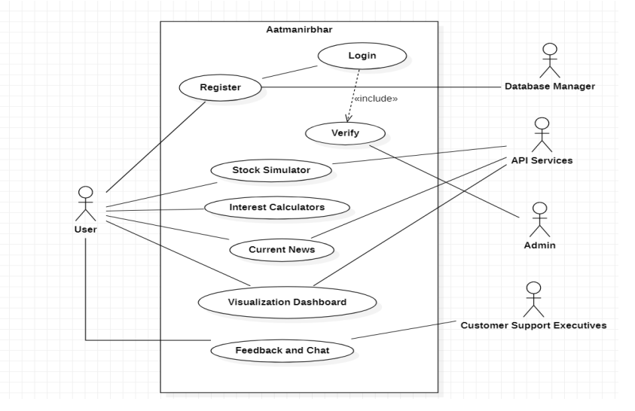
Use Case

Slide 6
Stakeholders
01
Customers-can change their buying habits, learn how to trade, be aware of market news
02
Suppliers - service providers like, alpha vantage, provide an updated stock value of all stocks of all exchanges in real time
03
Communities- community of novice investors, students, younger generation who can gather insight of trading from the website
04
Governments- is an external stakeholder, government rules and regulations affect trading policies substantially
05
Trade Associations- associations which promote trade, the product will prove to be an asset for association promotion

Slide 7
KLM Model Comparison
We have provided the user with selection list of companies. User can choose a stock from the list and visualize its graph.
Time taken by the user for the same can be calculated through KLM model:
DESCRIPTION | OPERATOR
Move Hand to Mouse | H=0.4s
Point to Selection List | P=1.1s
Click Selection List from Mouse | BB=0.2s
Point to Stock Name | P=1.1s
Click Stock Name from Mouse | BB=0.2s

Slide 8
KLM Model Comparison
If Search option was provided instead of Select and considering average typist.
DESCRIPTION | OPERATOR
Move Hand to Mouse and Place cursor on search box | HPBB = 1.7s
Move Hand to Keyboard and Type Stock Name (Reliance) | HKKKKKKKK= 0.4+(8*0.2) = 2s
Press Enter | K=0.2s
Time Taken by Search= 1.70+2+0.2=3.9 seconds
Time Taken by Select= 1.70+1.3=3 seconds

Slide 9
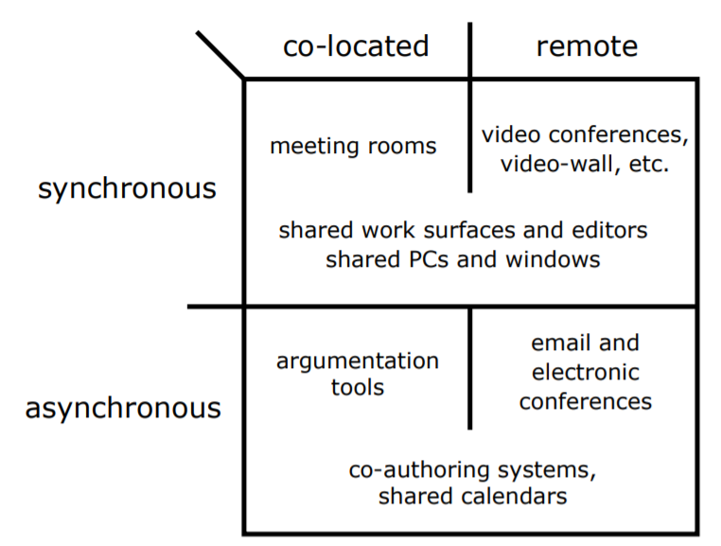
Communication
Video conferences - pervasive video for social contact
Shared Editors - Google slides, google docs, github
Shared Windows System - meet

Slide 10

Collaboration
Team Collaboration -Key to Project Success
Easy communication with the team- whatsapp groups
Being transparent of deadlines among members
Using collaboration tools

Slide 11
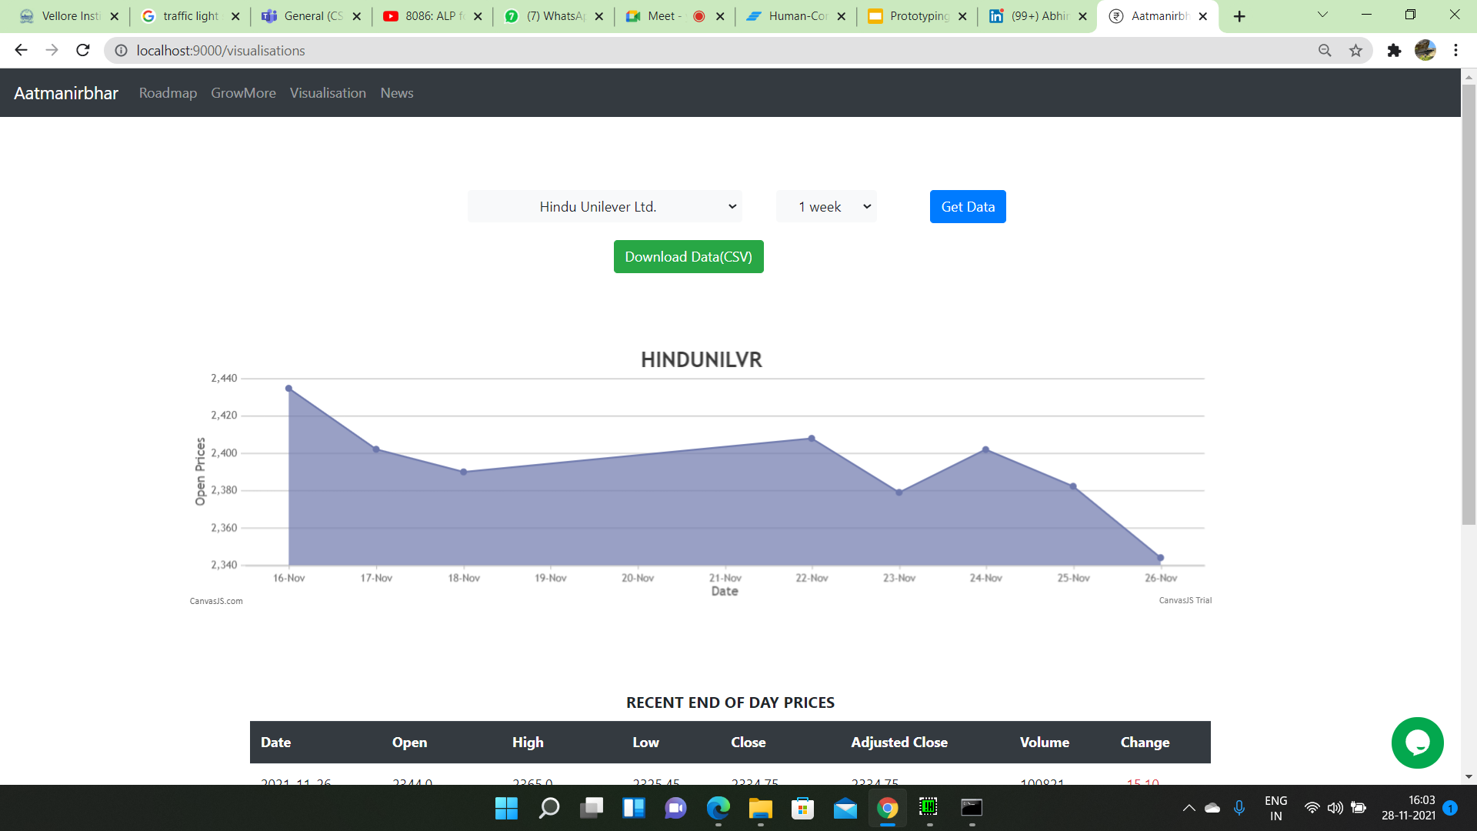
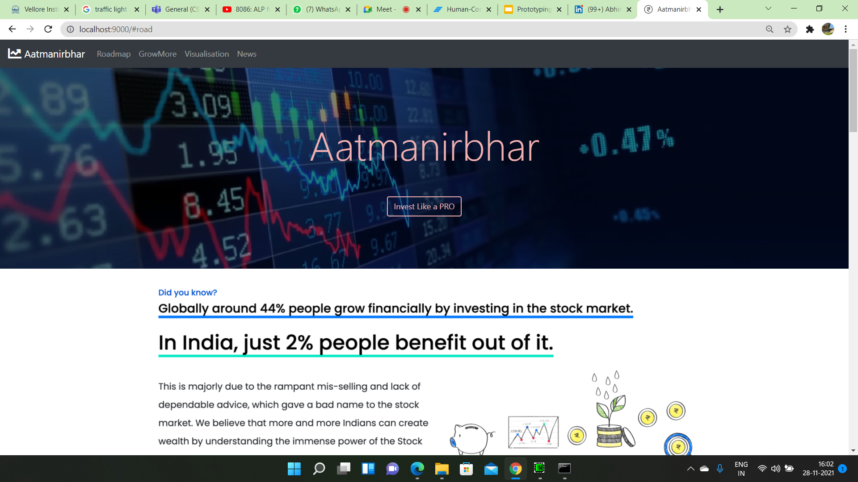
Shneiderman’s 8 Golden Rule
Strive for Consistency

Slide 12
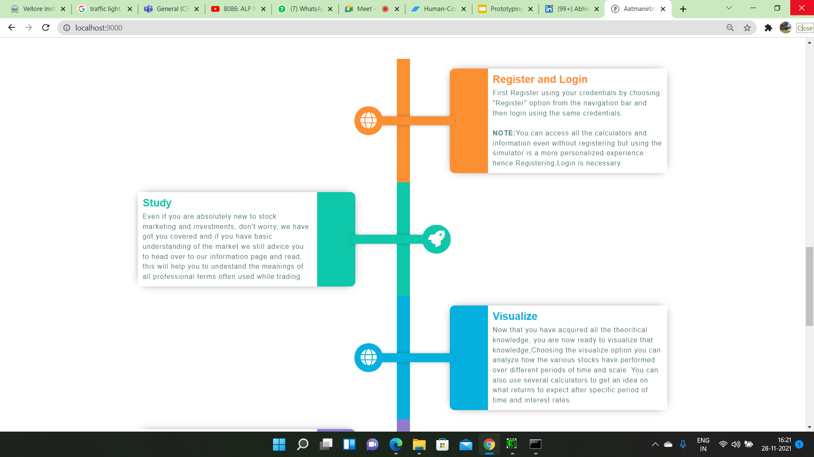
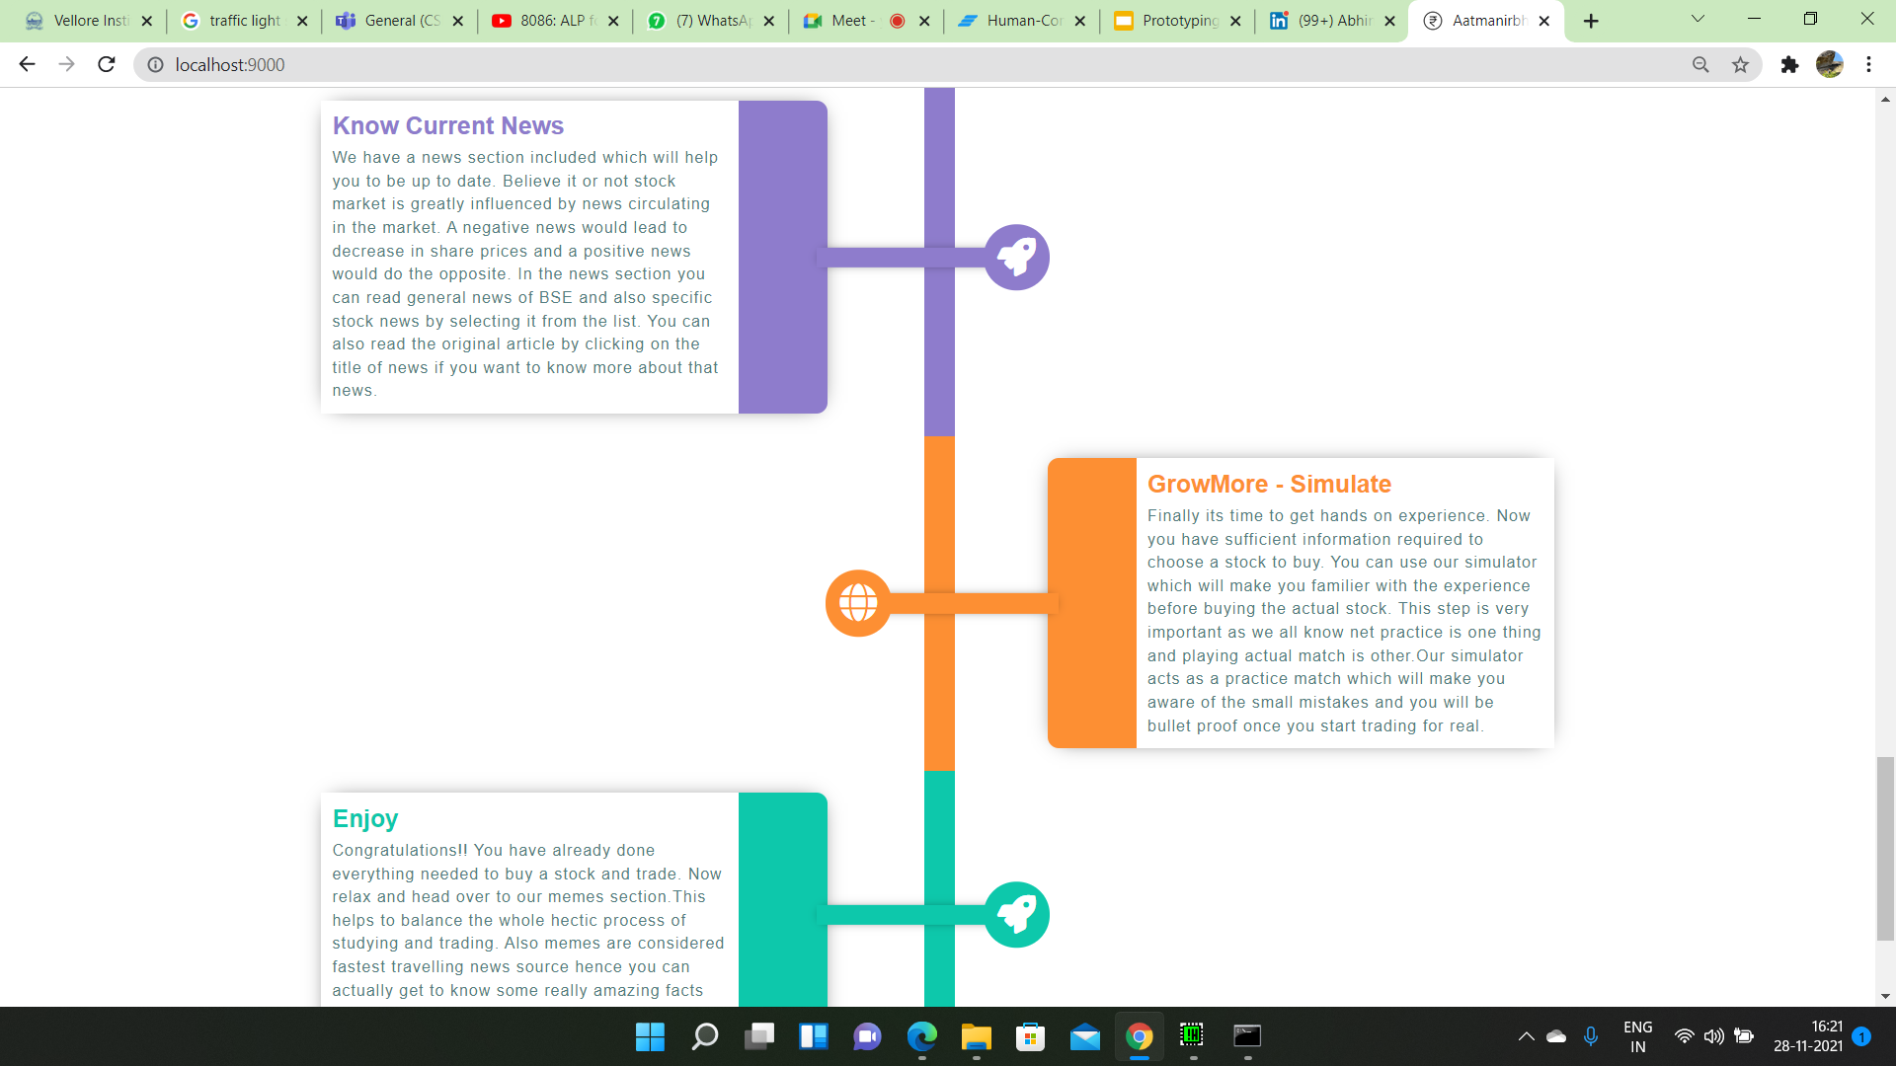
Shneiderman’s 8 Golden Rule
Cater to Universal Usability

Slide 13
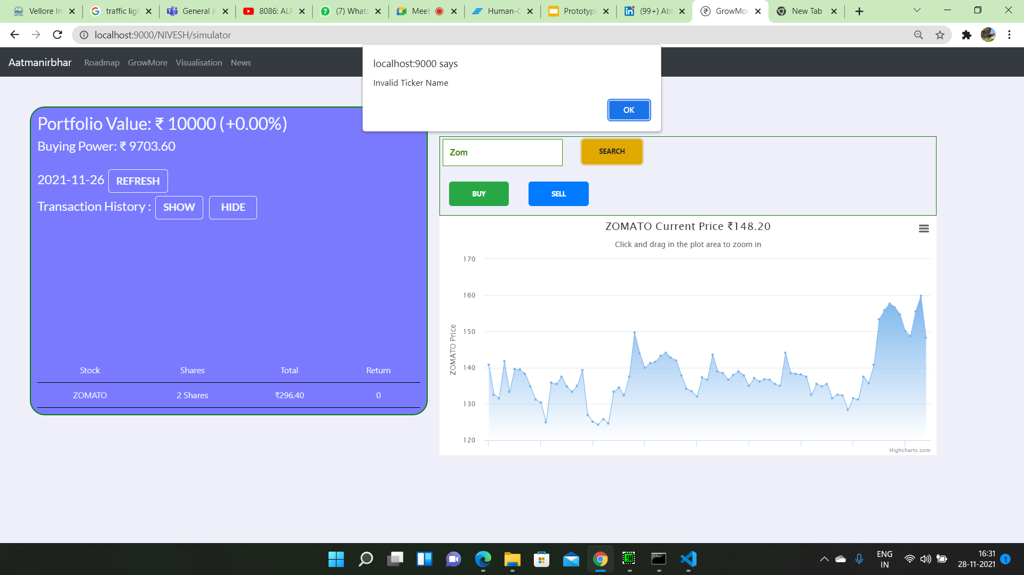
Shneiderman’s 8 Golden Rule
Offer Informative feedback

Slide 14
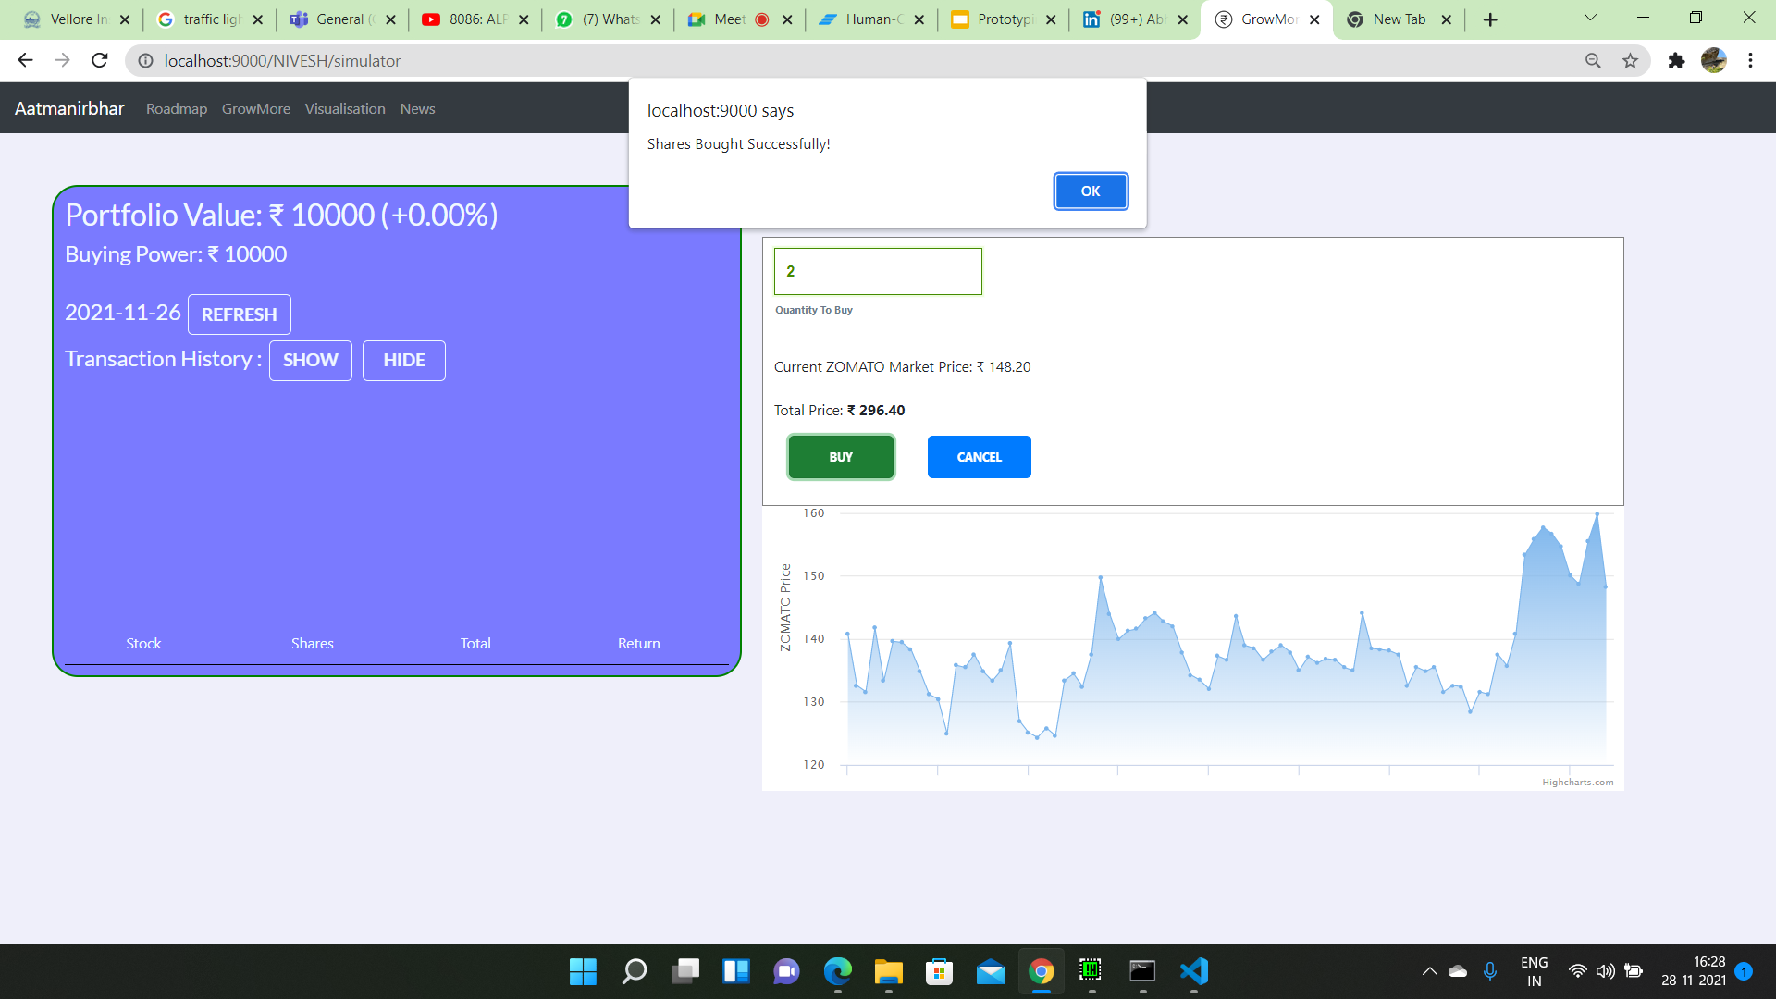
Shneiderman’s 8 Golden Rule
Design Dialogs to yield closure

Slide 15
Shneiderman’s 8 Golden Rule
Prevent Errors

Slide 16
Shneiderman’s 8 Golden Rule
Permit easy reversal of actions
UNDO/REDO option is not provided in our application because anxiety for buying shares is necessary as the application is helping user to learn stock market at a beginner level.
Because when user enters the real stock market the undo and redo of stocks is not possible and stocks need to be bought carefully.
That's why the anxiety amongst user is necessary.

Slide 17
Shneiderman’s 8 Golden Rule
Support internal locus of control
Visualization and Simulation are two independent modules of our project.
There is no compulsion of buying or selling after analysis is over.
User always has control of buying and selling after visualizing.

Slide 18
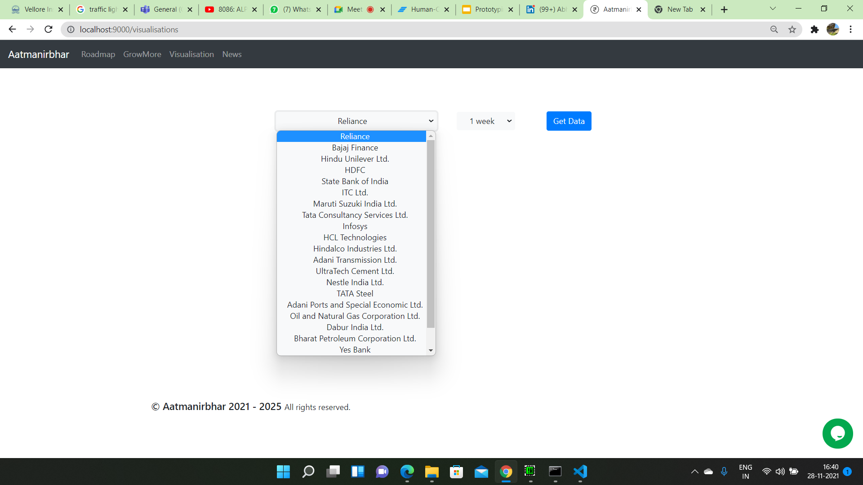
Shneiderman’s 8 Golden Rule
Reduce short term memory load

Slide 19

Thank you!

